Slide 1
Agent Management
Q1 2020

Slide 2

Context
There is no single place to find information about agents.
The management of our agent network is being managed across multiple spreadsheets.
Information, activities and communications are held across multiple tools and teams.
The current tooling landscape is overly complex - making it more costly to maintain, difficult to scale outside Nairobi, and impossible to sell as a Saas solution.

Slide 3
Who we spoke to?
Names are different across systems
Everyone comes to me because there is no unified view of agent
My spreadsheet is ‘the source of truth’ [All]
Team | Individual | Status
Agent Sales | Cynthia | Done
NOC | Sharon | Done
Deployment | Peter | Done
Finance | Humphrey | Done
Legal | Ashaba | Done
Fuels | Michael | Done
Marketing Ops | Naushad | Done
Stoves | Hezbon | Done
To do this, x sends me an email
The is no visibility on the health of an agent e.g. performance, sales, opening hours
Nowhere to track costs and spend
We can’t track communications, activities and disputes across agents
Can’t do tasks myself - a lack of access, training and automation

Slide 4
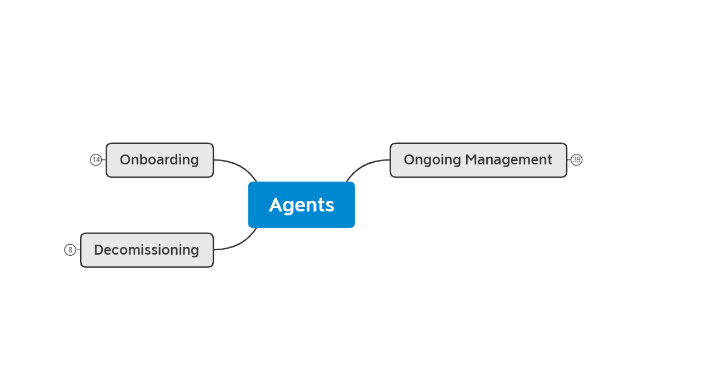
Agents Process and Activities Overview

Slide 5
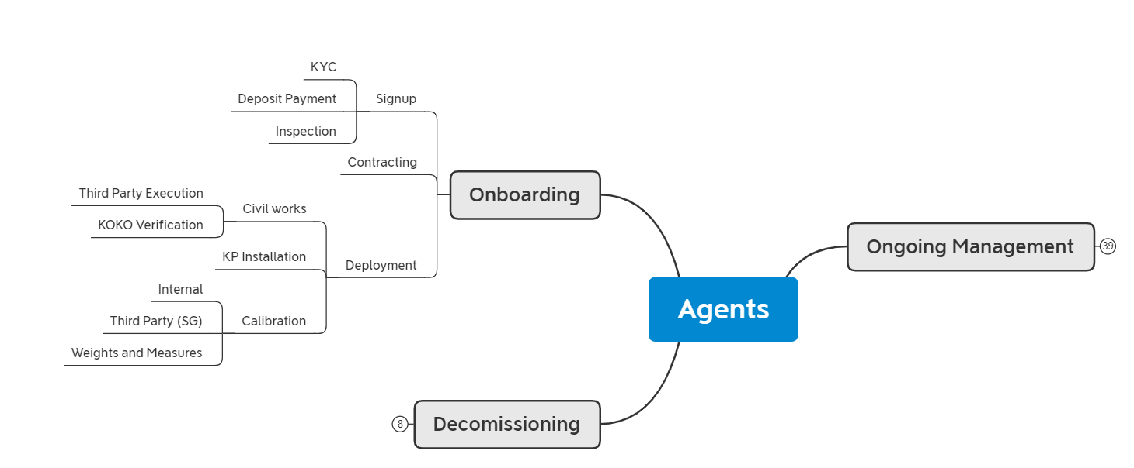
Agents Onboarding

Slide 6
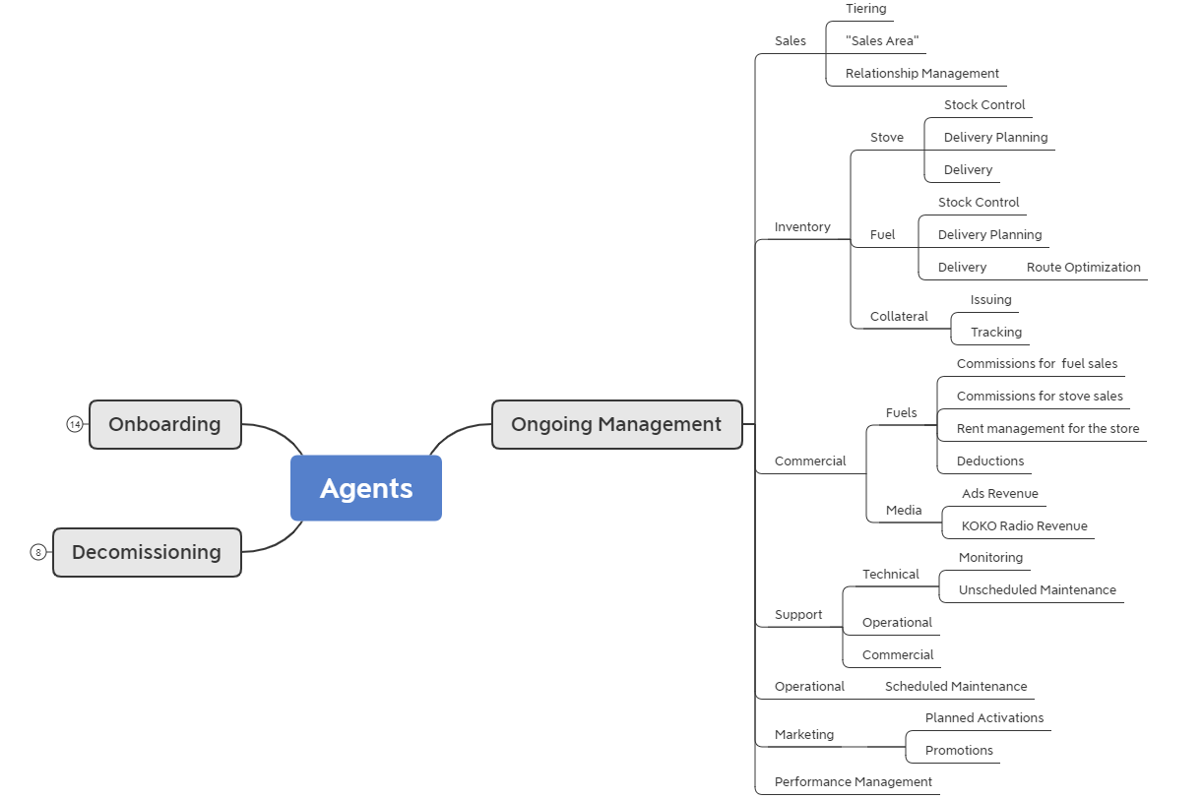
Agents Ongoing Management

Slide 7
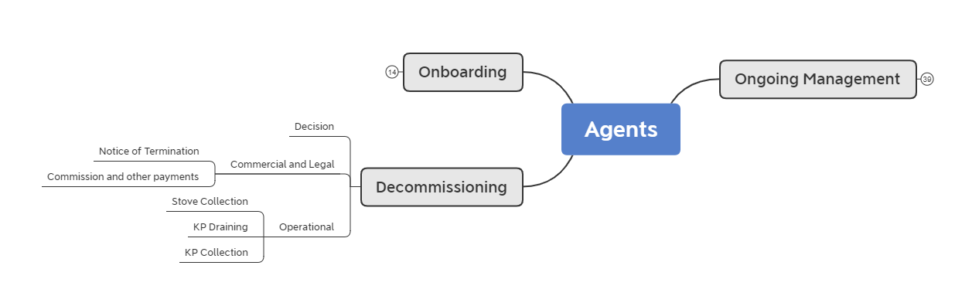
Agents Decommissioning

Slide 8
Pain points / opportunity areas
Different teams have been thinking about these problems separately
There have been a number of suggested improvements from each team about what would work for them
Now is the time to step back and think about a longer term solution that works for KOKO
Can’t license this set up to other markets
Can’t make strategic decisions
Can’t manage and operate the network because no one knows who has done what
The foundations tracking the agent network are weak due to disparate information being managed in different systems

Slide 9
Next steps
Review current roadmaps and look for overlap with existing initiatives
Map current tools to functionalities and detail pain points
Outline quick wins, short term and long term priority projects

Slide 10
Approach and Roadmap
How do we solve this

Slide 11
Roadmap approach
Sanitization of information sources - Understand the use of key identifiers and eliminate duplicates and redundancies
Bring information closer to Agents and RM’s (unified view of agent)
Improve internal coordination and ticketing - Interface between CX / NOC / RM’s etc to be driven by single ticketing system
Standardize communication mechanisms and feedback collection for/from agents. Incorporate agent performance into ongoing management
Fix decommissioning on system(s)
Simplify onboarding tools, data capture and data management
Improve commission management
Improve stock control for stoves in shops
Reduce teams using Odoo directly and have it more as a backend
Prereq before any other work can start
Unlock immediate value to biggest pain point areas, priority for Q1 and Q2
Near term fixes, required to improve the efficiency of the network late Q2 to Q4
Medium term fixes, required for beyond Nairobi and beyond Kenya

Slide 12
Unified view of agent
Summary
We need to ensure that everyone involved in the agent value chain has a unified view of the agent
Included
In Scope
Agent App where agents are able to access all of their information about planned activities, agent and KP status.
Field Team app for the relevant field teams to be able to access information about planned activities, agent and KP status in order to improve their ability to manage the agents
Unified view of the agent on KOKO Admin for all of the back office operational and support teams to access agent info
Incorporate critical information from spreadsheets into KOKO Admin / Odoo / Ticketing System to drive the unified view
Risks / Considerations
We need to ensure that critical information comes out of the spreadsheets that are being used
EXCO
Size / Complexity
Medium to High: 2 Serverside Engineers + 2 Android Eng initial estimate
Current Phase
Delivery

Slide 13
Step 0 - Sanitisation of data sources
Neighborhood
Nearest Landmark
Decommissioned status
Phone number 3
Phone number 2
Phone number 1 | Calib & W&M status | TDR Tasks
Agent Name | Commissioned status | Inspection Data
Shop Name | Opening Hours | Rent
Technical ID | Agent feedback / feedback about agents | Incentives and Prizes
Shop ID | Legal information | Deposits
Technical ID and shop ID need to be merged or linked as currently it is possible as it is remains a source of confusion and creates additional complexity for all the teams involved in agent management.
This information needs to be updated in KOKO Core and Odoo urgently. The data should be linked so that if agent name is changed in Odoo the change is reflected in KOKO Core. This will remove the need for a number of conflicting spreadsheets.
Short term Medium term Longer term
Further detail on data sources of truth and sanitisation can be found here.

Slide 14
Agent Service: Ongoing Management
Sales
Inventory
Commercial
Support
Marketing
AREAS
PILLARS
Agent Availability and Access
Communication Management
Performance Management
Customer Issue Support
Agent Inbound Issues
Planned Activations
Promotions
Tiering
Area Management
Relationship Management
Commissions for fuel sales
Commissions for stoves
Rent management for KPs
Deductions
KOKO media commissions
KOKO radio commissions
Collateral Issuing
Collateral Tracking
Fuel Stock Control
Fuel Delivery Planning
Fuel Delivery
ACTIVITIES & TOUCHPOINTS
Stove Stock Control
Stoves Delivery Planning
Stoves Delivery
Reverse Logistics
KP Monitoring
Unplanned Maintenance
Planned Maintenance
TEAMS
5
5
6
5
5
5
9
9
RM’s
Agent Sales Mgt
CX
NOC
Maintenance
Fuel
Stoves
Finance
Marketing

Slide 15
Overview Proposed Design Model
Agent App
Field Team App
Unified View of Agent (KA)
Keep
New
New proposed frontend apps
Review / Retire
Agent Service API
Existing systems
KOKO Core
Odoo
Zendesk
Freshservice
Tookan
Rationalize ticketing systems to have only 1
Critical information uploaded to relevant systems
Google Sheets

Slide 16
Unified view of agent - Next Steps
Scoping Document - with all of the detailed requirements
Design and validation for the various proposed interfaces for / with relevant user groups
Plan for migration of spreadsheet data into the relevant systems
Engineering Approach Doc
Implementation
Project folder: https://drive.google.com/drive/u/0/folders/1EKtRuu7GdCwqWXMrDILKiLd8RWs0NBwl
Software Roadmap:

Slide 17
Single Ticketing System
Summary
Network Operations and Customer Care use different ticketing systems. Some teams don’t use a ticketing system at all, A significant amount of additional work is created, and visibility / customer experience is impacted by this. We need a unified ticketing system across all teams.
Included
In Scope
Customer Care / call centre, Network Operations, Cooker Service team ticketing and workflows
Ensure all interactions about agents and internal interfaces about agent service are managed through a single ticketing system
Field staff interaction and integration with ticketing system
Reporting and visibility tools
Customisation of workflows
Data migration from previous ticketing systems
Risks / Considerations
Historically we have incorporated equipment management with ticketing, we need to unravel this into a separate requirement set and not conflate the two
EXCO
Size / Complexity
Large
Current Phase
Backlog

Slide 18





Ticketing Tools Landscape
Ticketing is done on 3 systems (Zendesk, Freshservice and Google Sheets)
Problem management is on Zendesk and Fresh Service
Asset Management is on Freshservice and Spreadsheets
Teams:
CX
Teams:
NOC
Fuel
Teams:
Stoves
Agent Mgt
Single Ticketing System
TICKETING
PROBLEM MANAGEMENT
ASSET MANAGEMENT

Slide 19
Single Ticketing System - Next Steps
Scoping of the asset management piece (how will this work in Odoo and KOKO Core)
Implementation of the asset management piece
Tool selection must include the broader call center tech strategy as part of the conversation
Migration to the single ticketing system
Integrations with KOKO Core and Odoo where relevant (scoping and implementation)
Project folder:
Software Roadmap:

Slide 20
Agent Comms, Performance and Feedback
Be able to contact an agent directly and have this logged
Use a single outbound number with which to contact agents directly
Central discoverable and accessible way to measure and show agent performance that is used by internal teams when managing the agents
Collect direct feedback from the Agent, Field Teams and Ops team about operational realities such as whether the shop is closed, if the road was changed etc that affect overall operational efficiency
Agents should be able to raise queries and issues that automatically go to the correct teams.

Slide 21
Tim Muchai / Alice Morton

